Slide 1
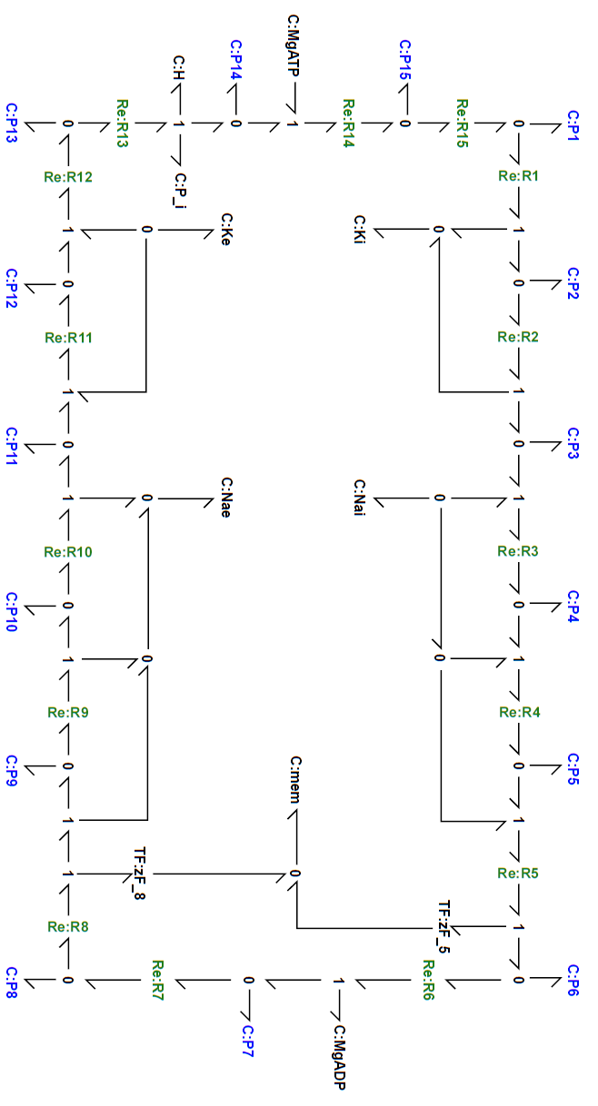






































































$$q_{i}^{P_{i}}$$
Mass balance:
$$q_{i}^{ATP}$$
$\frac{d}{dt}q_{m}^{E_{i}.2K^{+}.ATP}=v_{m}^{15}−v_{m}^{1}$
$\frac{d}{dt}q_{i}^{K^{+}}=v_{m}^{1}+v_{m}^{2}$
$$q_{m}^{E_{o}.P_{i}.2K^{+}}$$
$$v_{m}^{13}$$
$${Re}_{m}^{13}$$
$$v_{m}^{13}$$
$$q_{m}^{E_{o}.2K^{+}}$$
$$v_{m}^{14}$$
$${Re}_{m}^{14}$$
$$v_{m}^{14}$$
$$q_{m}^{E_{o}.2K^{+}.ATP}$$
$$v_{m}^{15}$$
$${Re}_{m}^{15}$$
$$v_{m}^{15}$$
$$q_{m}^{E_{i}.2K^{+}.ATP}$$
$\frac{d}{dt}q_{m}^{E_{i}.K^{+}.ATP}=v_{m}^{1}−v_{m}^{2}$
$\frac{d}{dt}q_{o}^{K^{+}}=−v_{m}^{11}−v_{m}^{12}$
$$v_{m}^{12}$$
$$v_{m}^{1}$$
$\frac{d}{dt}q_{m}^{E_{i}.ATP}=v_{m}^{2}−v_{m}^{3}$
$\frac{d}{dt}q_{i}^{{Na}^{+}}=−v_{m}^{3}−v_{m}^{4}−v_{m}^{5}$
$${Re}_{m}^{12}$$
$${Re}_{m}^{1}$$
$\frac{d}{dt}q_{m}^{E_{i}.ATP.{Na}^{+}}=v_{m}^{3}−v_{m}^{4}$
$\frac{d}{dt}q_{o}^{{Na}^{+}}=v_{m}^{8}$ $+v_{m}^{9}$ $+v_{m}^{10}$
$$q_{o}^{K^{+}}$$
$$v_{m}^{12}$$
$$v_{m}^{1}$$
$$q_{i}^{K^{+}}$$
$\frac{d}{dt}q_{m}^{E_{i}.ATP.2{Na}^{+}}=v_{m}^{4}−v_{m}^{5}$
$\frac{d}{dt}q_{i}^{ATP}=−v_{m}^{14}$
$$q_{m}^{E_{o}.P_{i}.K^{+}}$$
$$q_{m}^{E_{i}.K^{+}.ATP}$$
$\frac{d}{dt}q_{m}^{E_{i}.ATP.3{Na}^{+}}=v_{m}^{5}−v_{m}^{6}$
$\frac{d}{dt}q_{i}^{ADP}=v_{m}^{6}$
$$v_{m}^{11}$$
$$v_{m}^{2}$$
$\frac{d}{dt}q_{m}^{E_{i}.P_{i}.3{Na}^{+}}=v_{m}^{6}−v_{m}^{7}$
$\frac{d}{dt}q_{i}^{P_{i}}=v_{m}^{13}$
$${Re}_{m}^{11}$$
$${Re}_{m}^{2}$$
$\frac{d}{dt}q_{m}^{E_{o}.P_{i}.3{Na}^{+}}=v_{m}^{7}−v_{m}^{8}$
$$v_{m}^{11}$$
$$v_{m}^{2}$$
$\frac{d}{dt}q_{m}^{E_{o}.P_{i}.2{Na}^{+}}=v_{m}^{8}−v_{m}^{9}$
$\frac{d}{dt}q_{i}^{e}=z_{1}Fv_{m}^{5}+z_{2}Fv_{m}^{8}$
$$q_{m}^{E_{o}.P_{i}}$$
$$q_{m}^{E_{i}.ATP }$$
$\frac{d}{dt}q_{m}^{E_{o}.P_{i}.{Na}^{+}}=v_{m}^{9}−v_{m}^{10}$
$$q_{o}^{{Na}^{+}}$$
$$v_{m}^{10}$$
$$v_{m}^{3}$$
$$q_{i}^{{Na}^{+}}$$
$\frac{d}{dt}q_{m}^{E_{o}.P_{i} }=v_{m}^{10}−v_{m}^{11}$
$${Re}_{m}^{10}$$
$${Re}_{m}^{3}$$
$\frac{d}{dt}q_{m}^{E_{o}.P_{i}.K^{+}}=v_{m}^{11}−v_{m}^{12}$
$$v_{m}^{10}$$
$$v_{m}^{3}$$
$\frac{d}{dt}q_{m}^{E_{o}.P_{i}.2K^{+}}=v_{m}^{12}−v_{m}^{13}$
$$q_{m}^{E_{o}.P_{i}.{Na}^{+}}$$
$$q_{m}^{E_{i}.ATP.{Na}^{+}}$$
$\frac{d}{dt}q_{m}^{E_{o}.2K^{+}}=v_{m}^{13}−v_{m}^{14}$
$$v_{m}^{9}$$
$$v_{m}^{4}$$
$\frac{d}{dt}q_{m}^{E_{o}.2K^{+}.ATP}=v_{m}^{14}−v_{m}^{15}$
$${Re}_{m}^{9}$$
$${Re}_{m}^{4}$$
Reaction fluxes
$$v_{m}^{9}$$
$$v_{m}^{4}$$
$$v_{m}^{1}=κ_{1}\left[{\overline{q}}_{m}^{E_{i}.2K^{+}.ATP}−{\overline{q}}_{m}^{E_{i}.K^{+}.ATP}.{\overline{q}}_{i}^{K^{+}}\right]$$
$$q_{m}^{E_{i}.P_{i}.2{Na}^{+}}$$
$$q_{m}^{E_{i}.ATP.2{Na}^{+}}$$
$$v_{m}^{2}=κ_{2}\left[{\overline{q}}_{m}^{E_{i}.K^{+}.ATP}−{\overline{q}}_{m}^{E_{i}.ATP}.{\overline{q}}_{i}^{K^{+}}\right]$$
$$v_{m}^{8}$$
$$v_{m}^{5}$$
$$v_{m}^{3}=κ_{3}\left[{\overline{q}}_{m}^{E_{i}.ATP}.{\overline{q}}_{i}^{{Na}^{+}}−{\overline{q}}_{m}^{E_{i}.ATP.{Na}^{+}} \right]$$
$${Re}_{m}^{8}$$
$${Re}_{m}^{5}$$
$$v_{m}^{4}=κ_{4}\left[{\overline{q}}_{m}^{E_{i}.ATP.{Na}^{+}}.{\overline{q}}_{i}^{{Na}^{+}}−{\overline{q}}_{m}^{E_{i}.ATP.2{Na}^{+}} \right]$$
$$v_{m}^{8}$$
$$z_{2}F$$
$$u_{m}^{e}$$
$$z_{1}F$$
$$v_{m}^{5}$$
$$v_{m}^{5}=κ_{5}\left[{\overline{q}}_{m}^{E_{i}.ATP.2{Na}^{+}}.{\overline{q}}_{i}^{{Na}^{+}}−{\overline{q}}_{m}^{E_{i}.ATP.3{Na}^{+}}.e^{z_{1}Fu_{m}^{e}/RT}\right]$$
$$q_{m}^{E_{o}.P_{i}.3{Na}^{+}}$$
$$v_{m}^{7}$$
$${Re}_{m}^{7}$$
$$v_{m}^{7}$$
$$q_{m}^{E_{i}.P_{i}.3{Na}^{+}}$$
$$v_{m}^{6}$$
$${Re}_{m}^{6}$$
$$v_{m}^{6}$$
$$q_{m}^{E_{i}.ATP.3{Na}^{+}}$$
$$q_{i}^{ADP}$$
$$v_{m}^{6}=κ_{6}\left[{\overline{q}}_{m}^{E_{i}.ATP.3{Na}^{+}} −{\overline{q}}_{m}^{E_{i}.P_{i}.3{Na}^{+}}.{\overline{q}}_{i}^{ADP}\right]$$
$$v_{m}^{7}=κ_{7}\left[{\overline{q}}_{m}^{E_{i}.P_{i}.3{Na}^{+}}−{\overline{q}}_{m}^{E_{o}.P_{i}.3{Na}^{+}} \right]$$
$$v_{m}^{8}=κ_{8}\left[{\overline{q}}_{m}^{E_{o}.P_{i}.3{Na}^{+}}−{\overline{q}}_{m}^{E_{o}.P_{i}.2{Na}^{+}}.{\overline{q}}_{o}^{{Na}^{+}}.e^{z_{2}Fu_{m}^{e}/RT}\right]$$
$$v_{m}^{9}=κ_{9}\left[{\overline{q}}_{m}^{E_{o}.P_{i}.2{Na}^{+}}−{\overline{q}}_{m}^{E_{o}.P_{i}.{Na}^{+}}.{\overline{q}}_{o}^{{Na}^{+}} \right]$$
$$v_{m}^{10}=κ_{10}\left[{\overline{q}}_{m}^{E_{o}.P_{i}.{Na}^{+}}−{\overline{q}}_{m}^{E_{o}.P_{i}}.{\overline{q}}_{o}^{{Na}^{+}} \right]$$
$$v_{m}^{11}=κ_{11}\left[{\overline{q}}_{m}^{E_{o}.P_{i}}.{\overline{q}}_{o}^{K^{+}}−{\overline{q}}_{m}^{E_{o}.P_{i}.K^{+}} \right]$$
$$v_{m}^{12}=κ_{12}\left[{\overline{q}}_{m}^{E_{o}.P_{i}.K^{+}}.{\overline{q}}_{o}^{K^{+}}−{\overline{q}}_{m}^{E_{o}.P_{i}.2K^{+}} \right]$$
$$v_{m}^{13}=κ_{13}\left[{\overline{q}}_{m}^{E_{o}.P_{i}.2K^{+}} −{\overline{q}}_{m}^{E_{o}.2K^{+}}.{\overline{q}}_{i}^{P_{i}}\right]$$
$$v_{m}^{14}=κ_{14}\left[{\overline{q}}_{m}^{E_{o}.2K^{+}}.{\overline{q}}_{i}^{ATP}−{\overline{q}}_{m}^{E_{o}.2K^{+}.ATP} \right]$$
$$v_{m}^{15}=κ_{15}\left[{\overline{q}}_{m}^{E_{o}.2K^{+}.ATP} −{\overline{q}}_{m}^{E_{i}.2K^{+}.ATP} \right]$$

